Slide 1
Source Generators in .NET
Michal Horák

Slide 2
What are Source Generators?
Compile-time code generation feature
Allows to generate additional source code during compilation
Part of the Roslyn compiler platform
Works with .NET Standard 2.0

Slide 3
How Source Generators work?
Input: The compiler feeds the generator with metadata, syntax trees, and semantic information about your code.
Execution: Your generator code analyzes this input and generates new C# code.
Output: The generated code is compiled alongside your original code, resulting in a single, optimized assembly.

Slide 4
How Source Generators work? - Characteristics
Compile-time generation - Generates code before runtime, improving performance and reducing runtime dependencies.
Seamless integration - Works with existing .NET tooling (Visual Studio, dotnet CLI, etc.).
Attribute-based - Often triggered by custom attributes, making it easy to integrate with libraries.
Incremental - Only regenerates code when inputs change, improving build times.
No runtime overhead - Generated code is compiled into the assembly, not interpreted at runtime.
Works with analyzers - Can be combined with Roslyn analyzers for advanced scenarios.

Slide 5
Why use Source Generators? - Use cases
Boilerplate reduction - INotifyPropertyChanged, Equals, GetHashCode
Serialization/Deserialization - JSON, XML
Dependency Injection - auto-registering services
API generation - OpenAPI/Swagger clients
Performance optimizations - inlining, caching
Dynamic proxy generation - AOP, mocking

Slide 6
Why use Source Generators? - Advantages
Performance - Generated code is compiled, not interpreted, improving runtime performance.
Compile-time safety - Catches errors during compilation, not at runtime.
Reduced boilerplate - Eliminates repetitive code, making codebases cleaner and more maintainable.
No runtime dependencies - Generated code is part of the assembly, so no additional libraries are needed.
Incremental builds - Only regenerates code when inputs change, speeding up build times.
Integration with .NET ecosystem - Works seamlessly with IDEs, dotnet CLI, and other tooling.
Flexibility - Can generate any valid C# code, from simple methods to complex classes.

Slide 7
Why not use Source Generators? - Disadvantages
Learning curve - Requires understanding of Roslyn APIs and compilation concepts.
Debugging complexity - Generated code is not visible in the debugger, making debugging harder.
Build-time impact - Can slow down compilation if overused or poorly optimized.
Limited runtime behavior - Cannot generate code based on runtime values (only compile-time data).
Overhead for simple cases - For very simple scenarios, the overhead of writing a generator may not be justified.
Generators cannot be chained

Slide 8
How to make custom Source Generator

Slide 9
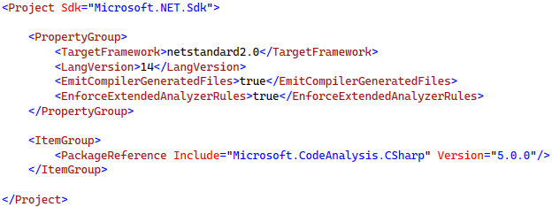
How to make Source Generator - .csproj

Slide 10
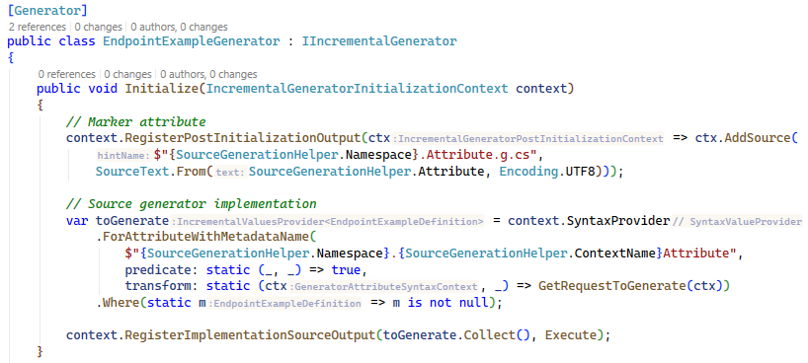
How to make Source Generator - Generator

Slide 11
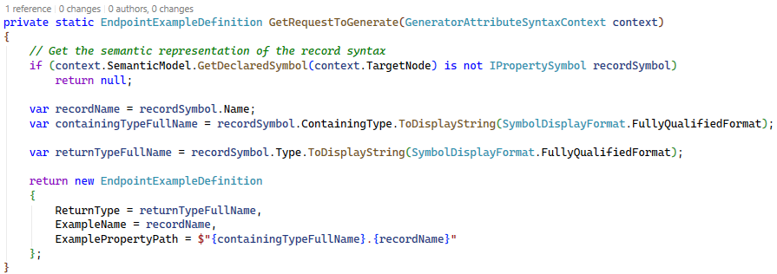
How to make Source Generator - Generator

Slide 12
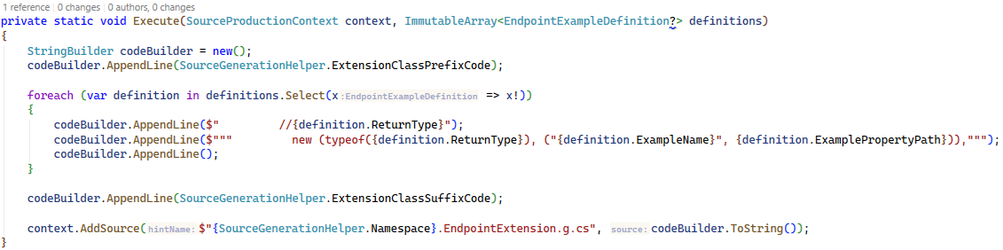
How to make Source Generator - Generator

Slide 13
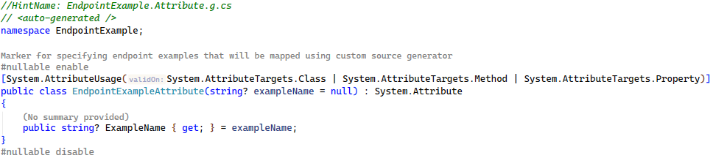
How to make Source Generator - Result files

Slide 14
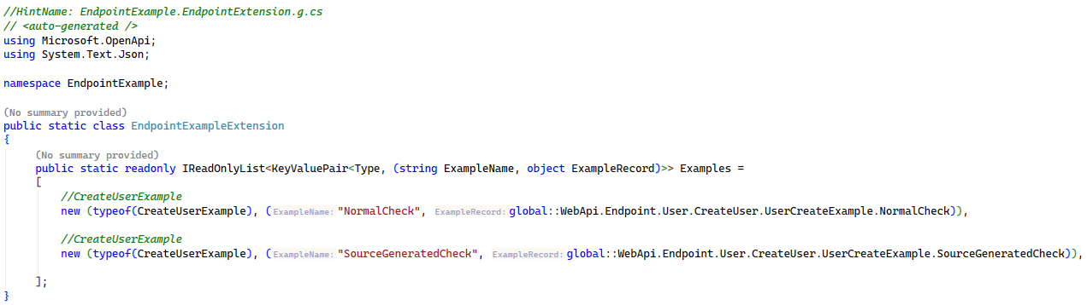
How to make Source Generator - Result files

Slide 15
How to use Source Generators

Slide 16
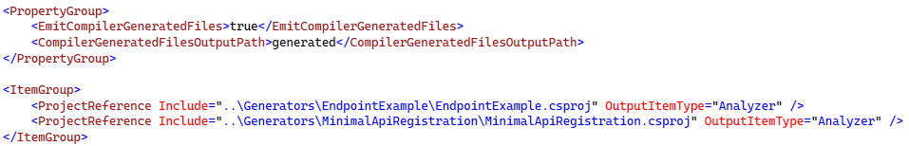
How to use Source Generators - .csproj

Slide 17
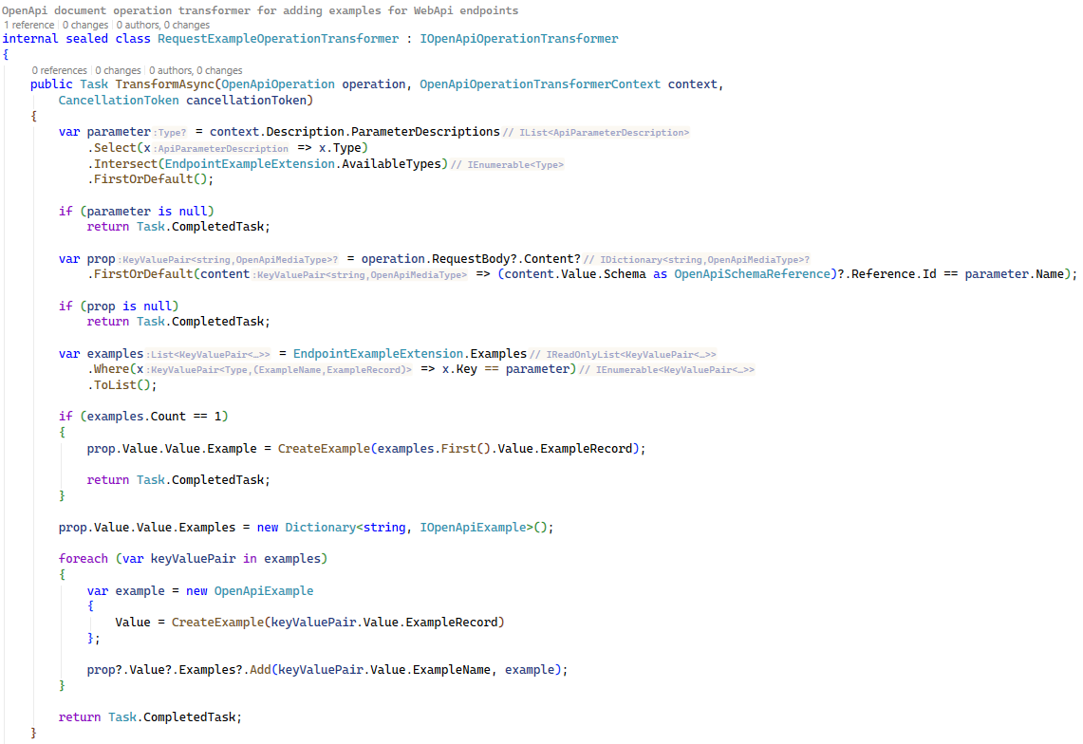
How to use Source Generators - Transformer

Slide 18
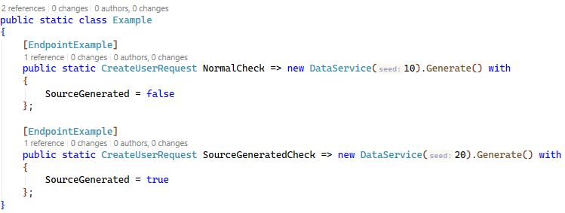
How to use Source Generators - Usage

Slide 19
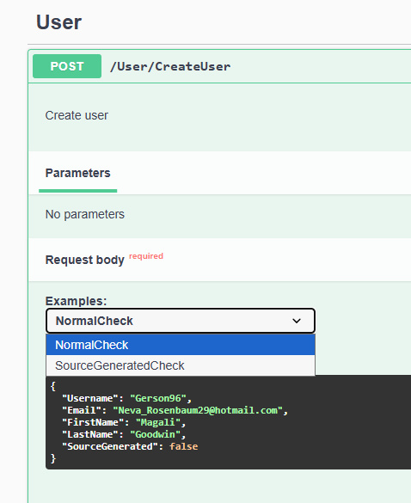
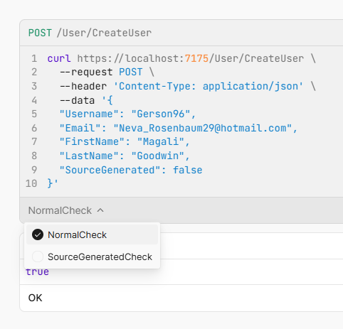
How to use Source Generators - Result

Slide 20
Live demonstration of Source Generators

Slide 21
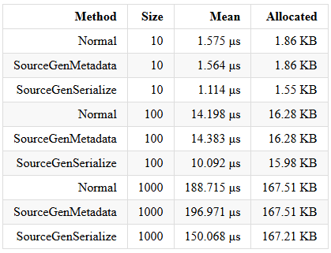
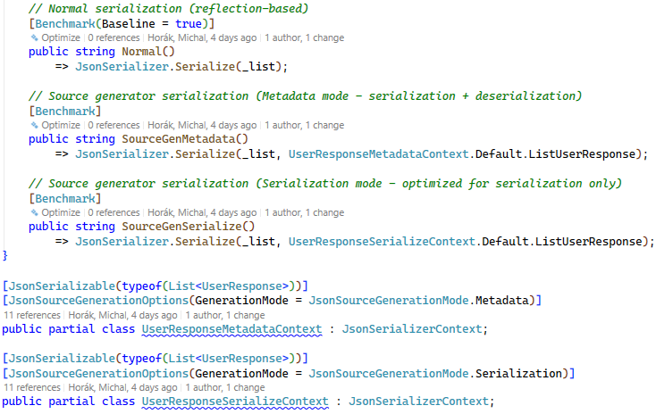
Examples of Source Generators - JsonSerialization

Slide 22
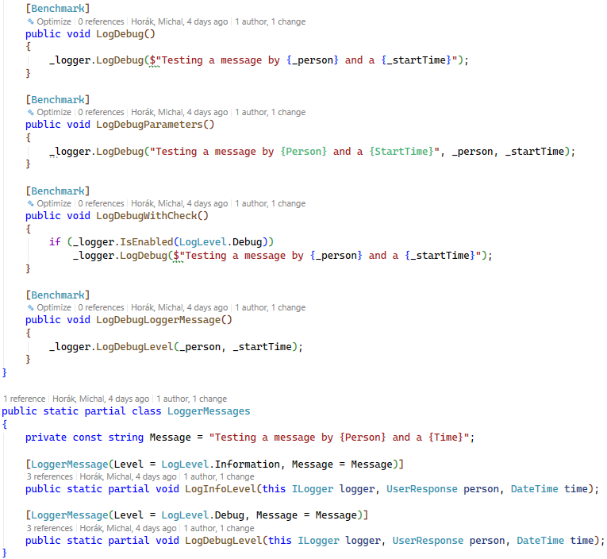
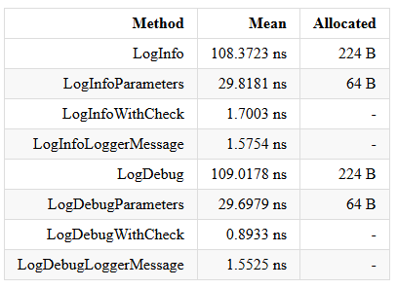
Examples of Source Generators - LoggerMessage

Slide 23
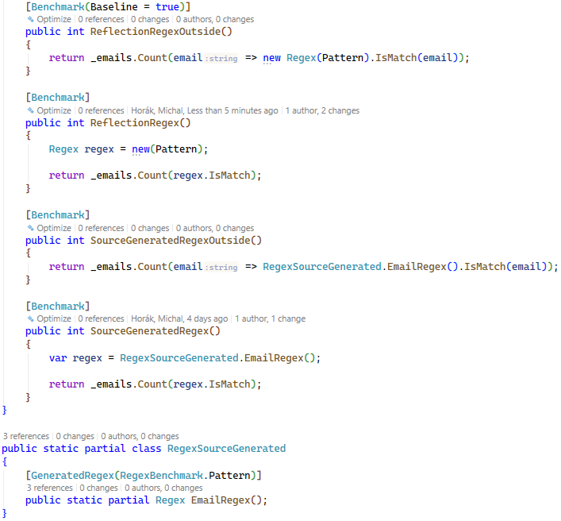
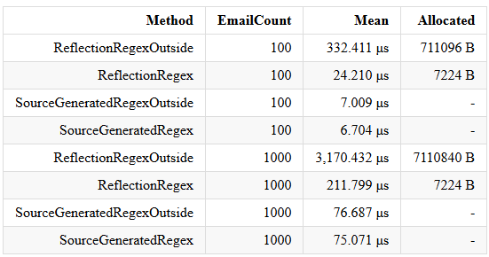
Examples of Source Generators - Regex

Slide 24
Additional resources on Source Generators
Microsoft | Introducing C# Source Generators
Andrew Lock | Creating an incremental generator series
GitHub | C# Source Generators

Slide 25
The End
Questions on Source Generators?

Slide 26

GitHub repository

